Slide 1
You’re the Tech Lead… YOU fix it!
Over the last couple of years, I've presented 20 tricks and tips that I've found invaluable as a Tech Lead. But in this session, I want to turn things around and look at applying some of those to solving specific issues that are common within many software development teams.
I'll be taking lessons learned from the last 2 years of a major development project and using them to illustrate my points.
We'll look at managing your BAs and PMs and how to balance their need to understand exactly how long everything takes versus your team's need to not be over-pressured by artificial deadlines.
We'll see how a structured approach to analysing problems encountered in LIVE can make everyone's life easier, and how to prove whether the problem is (or is not) the fault of your software. And how to handle that inevitable case where it is.
And we'll look at the problems of implementing uniformity across multiple code-bases and multiple teams delivering multiple releases of multiple features... and where getting your tooling right can give the biggest benefits.
Amongst other things...
W: https://www.hammond-turner.org.uk
E: joel@Hammond-turner.org.uk
T: @Rammesses

Slide 2

You’re the Tech Lead… YOU fix it!
Joel Hammond-Turner
e: joel@hammond-turner.org.uk
t: @rammesses
Notes:
Introduce yourself
New talk - Blame Joe if it’s a disaster (I’ll take credit if it’s good)
Part after-action report, part re-work of 20 things – with anecdotes so hopefully interesting
See if you can spot the Easter eggs!

Slide 3
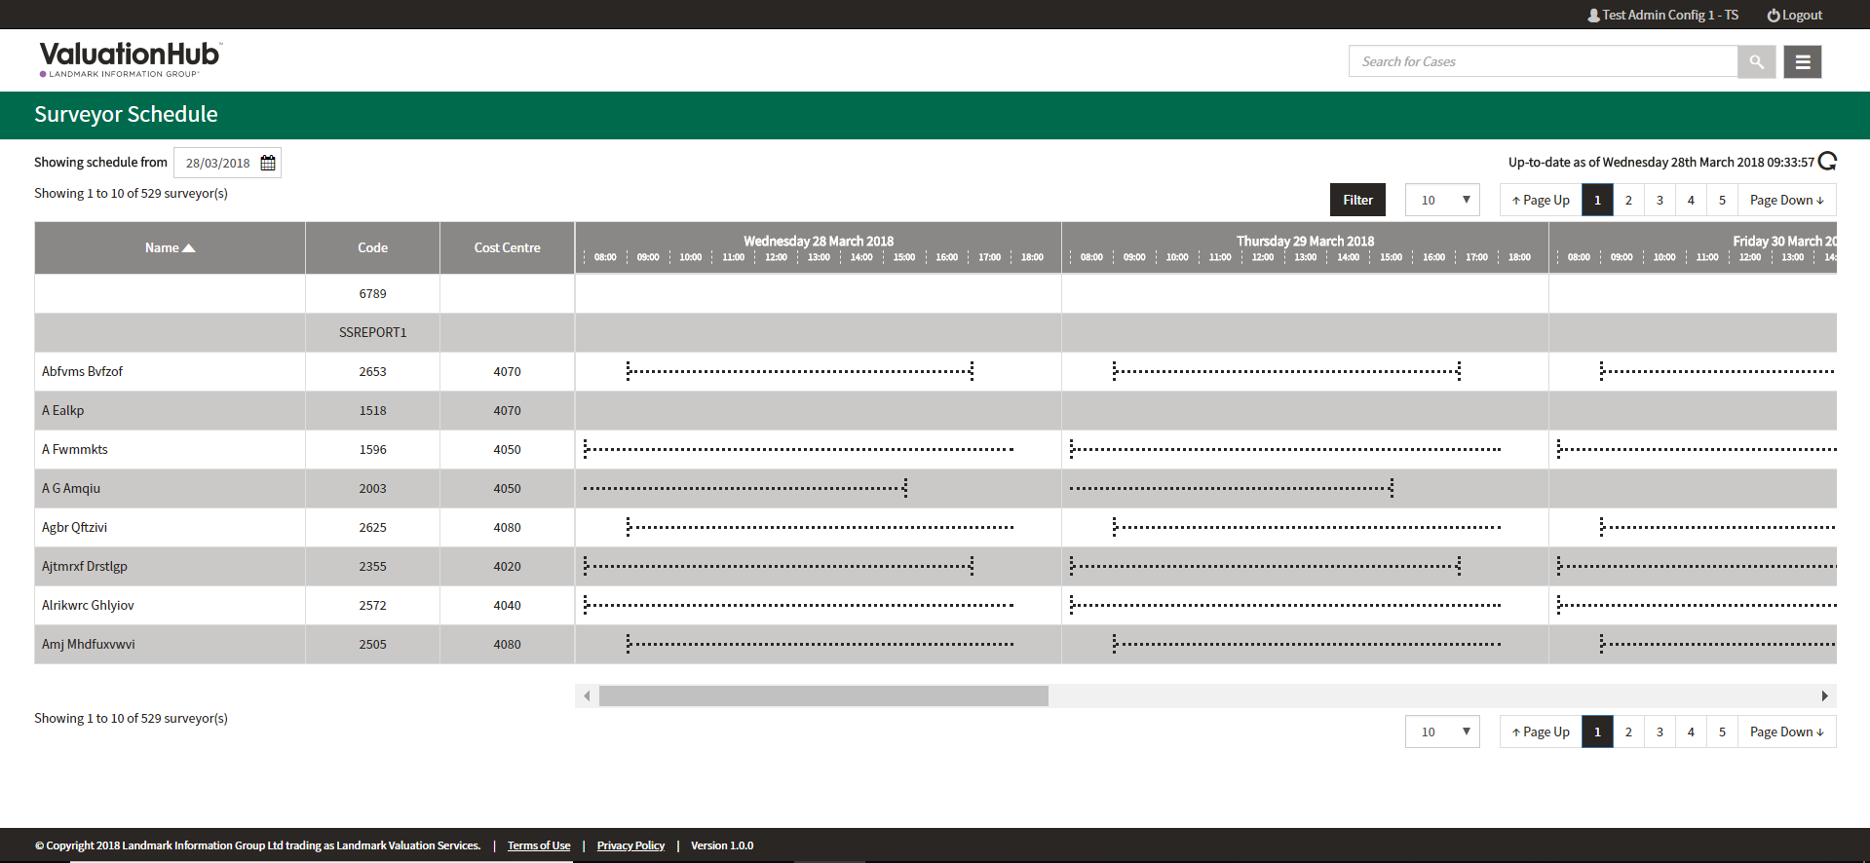
Some Background
Landmark Valuation Hub
“End to end residential property transaction lifecycle management, seamlessly coordinating Lender and Surveyor case management through configurable workflow. Valuation Hub is your window into the Secure Panel Network, providing Lenders access to the community of UK Surveyors, and enabling Surveyors to complete cases securely, accurately and on time, every time”
Notes:
An ecosystem of products – mobile capture, forensics, case management, transaction brokerage
Core product 95% of the market for 20 years – now competition

Slide 4
You, vs the World (of PMs)
Image © Universal Pictures 2010

Slide 5
“So here’s the PBIs you’re doing this sprint”

Slide 6
“So here’s the PBIs you’re doing this sprint”
Scoping before estimates – BAD
Scope-driven delivery – BAD
PM-driven breakdowns – BAD
The team must break-down the work
Preferably before the sprint
PBIs must be deployable & testable and integrated – DoD
Anything else is either a Task or an Epic

Slide 7
”So how long is it REALLY going to take?”
How good are your estimates? Really?
Development
Testing
Integration
Deployment
Estimation only improves with iteration and experience
Known-Knowns / Known-Unknowns / Unknown-Unknowns

Slide 8
“Why bother about this ‘Tech Debt’ then?”
YAGNI vs cohesion
Add to your backlog as soon as you find it
Prioritisation / Pruning of Tech Debt is YOUR responsibility
When tech debt bites
Don't always do *just enough*
Celebrate little wins
Code Gardening
”So you really want to ignore this known bug until it bites us?”
Image © Universal Pictures 1993
Notes:
YAGNI vs cohesion
Backlog pruning
When tech debt bites
Don't always do *just enough*
VS2017 uplift failures
Celebrate little wins - .Net 462 upgrade of QT_CommsSvr ("could have used a Dictionary")
So you really want to ignore this known bug until it bites us?

Slide 9
You, vs the World (of PMs)
Take (& keep) control of estimation
Slice and dice the work
Deployable & testable, Integration, Dependencies
Breaking down the requirement (again)
Estimating the unknown-unknows
Tech Debt
YAGNI vs cohesion
Backlog pruning
Don't always do *just enough*
Celebrate little wins
Don’t ignore known bugs until they bites. Just don’t.

Slide 10
When the World Falls Down
Photo by Andrés Gerlotti

Slide 11
“It can’t be OUR fault!”
<CODE />
Photo by Mimi Thian
Notes:
Product – Legacy Forensics
Symptoms - some transactions were hanging - but not all
Log Files - showed nothing
Correlation - no changes EXCEPT an infastructure change
Proof - located the code pointing to the share, verified that share was not accessible from server
Fix - fix the shares. Restart servies.
SHOW THE CODE!

Slide 12
“It can’t be OUR fault!”
Logging, logging, logging…
More logging…
Bad logging can be worse than no logging
Correlation is everything
Keep *SOME* documentation on what resources your software uses.
Hard-coded paths in your software are BAD
Hard-coded (i.e. not transformed) configuration is also BAD
Photo by Mimi Thian

Slide 13
“OK. It’s our fault.”
<CODE />
Photo by Joey Banks
Notes:
Product – Legacy Synchronisation Engine – recently updated
Symptoms - Some transactions were failing after a LONG time
SHOW THE LOG FILES
Log Files - nothing obvious, had to write an app to correlate
Correlation - added loads more logging - showed exceptions logged after long delays to requests - thread starvation / socket starvation in HTTP Client.
Proof – additional logging & code review showed a N+1 calls to service – should have been refactored when updated
Fix - implement a new API to bring it all back at once
SHOW THE CODE
Single-threaded web server – BAD
Hand-rolled multi-threading – BAD
Sync/Async hand-off – BAD
Final fix – 2000% perf increase

Slide 14
“OK. It’s our fault.”
Legacy code is a minefield
Custom implementations of framework features are a red flag
NEVER allow N+1 code
if you find it, fix it.
HttpClient is a PITA
see Steve Gordon's blog
Photo by Joey Banks

Slide 15
When the World Falls Down
Logging, logging, logging
Correlation of cause can be hard
Work the problem – Logically
Proof negative is as important as proof positive
Accept responsibility – even if it hurts

Slide 16
Taming the Off-Shore Beast (and the on-shore one too)
Photo by Mohamed Ahsan

Slide 17
Some Background
Partnership with UST Global
Scalable off-shore development resource
Relationship
Trialed with small changes
Extended with full features
Multiple teams
Work out of Landmark-branded offices
“Virtual Employees”

Slide 19
Silos are great… except they’re not
Avoid cross-team dependencies
Less merge conflicts
Independent delivery
Last-minute integration effort
Photo by Jim Witkowski

Slide 21
You’ll do it… my… way.
Consistency in code
Coding Standards
Checklists
Developer
Code Review
Pull Request
Consistency allows for resiliency
Image © 1982 Walt Disney Pictures

Slide 22
You’ll do it… my… way.
Tools
StyleCop / FxCop
Sonar
Snyk
Code coverage
Once… Twice… Package!
Image © 1982 Walt Disney Pictures

Slide 24
One team…
Communication is essential
Tech Leads call
Clean Code Sessions
Pairing (inc remotely)
Photo by Annie Spratt
Notes:
DON’T just comment on PRs
DON’T just DIY and push as done
DO explain the rationale

Slide 25
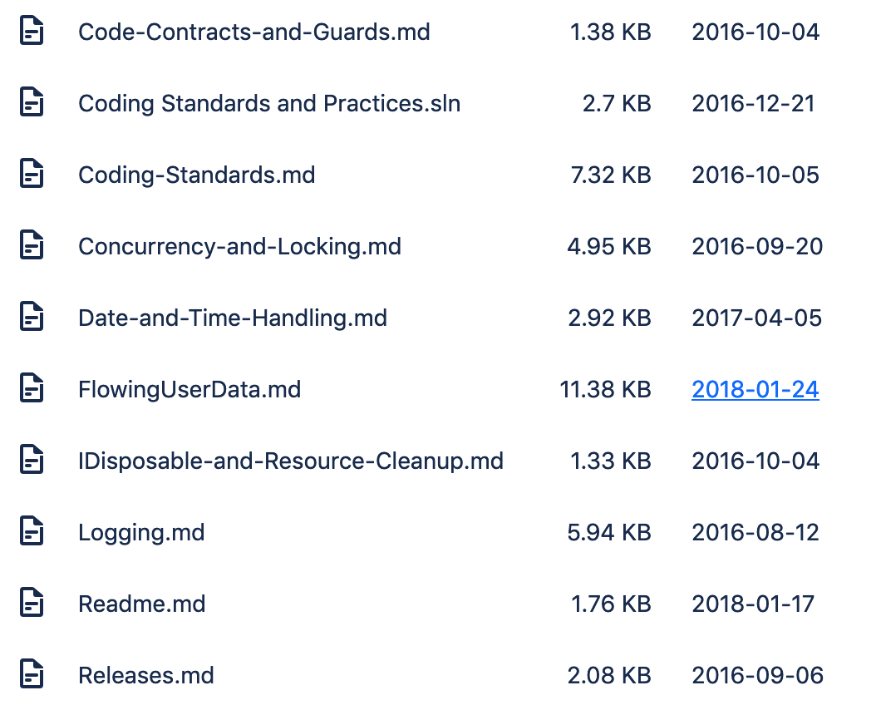
One team…
DOCUMENT your standards
Repo with MD files
Don’t use Sharepoint!
Communicate
Teams is OK – Slack is better
No email chains
(Also don’t involve Management unnecessarily!)

Slide 26
Taming the Beast(s)
Coding Standards
StyleCop / FxCop
Warnings as Errors
Sonar
Developer Checklist
Deep Dives
Package for Re-use
IoC bootstrapping
Test Coverage
Ncrunch - green blobs
Off-shore lead - on-board
Tech Leads catchups
Clean Code sessions
Reference implementations
Moving Target
Keeping them up to date is hard

Slide 27
Questions ?
Photo © US Government 2009

Slide 28
You’re the Tech Lead… YOU fix it!
Repo: https://bit.ly/YouFixIt-Repo
Deck: https://bit.ly/YouFixIt-Deck
Feedback: https://bit.ly/YouFixIt-Feedback
Joel Hammond-Turner
e: joel@hammond-turner.org.uk
t: @rammesses

